Slide 1



Who all are written medium blogs

Slide 2
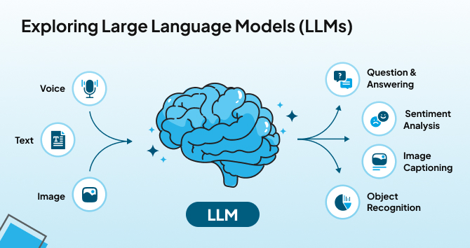








1. What Are Large Language Models (LLMs)?
Large Language Models (LLMs) are advanced artificial intelligence systems designed to understand and generate human-like text. Built upon deep learning architectures, particularly transformers, these models are trained on vast datasets encompassing books, articles, and web content. Through this extensive training, LLMs learn the nuances of language, enabling them to perform a variety of tasks such as answering questions, drafting content, translating languages, and summarizing information. Their versatility has led to applications across numerous fields, including customer service, content creation, and code generation. However, despite their impressive capabilities, LLMs can sometimes produce incorrect or biased outputs, reflecting the data they were trained on. Ongoing research aims to enhance their accuracy, fairness, and efficiency.
https://artificialanalysis.ai/leaderboards/models

Slide 3
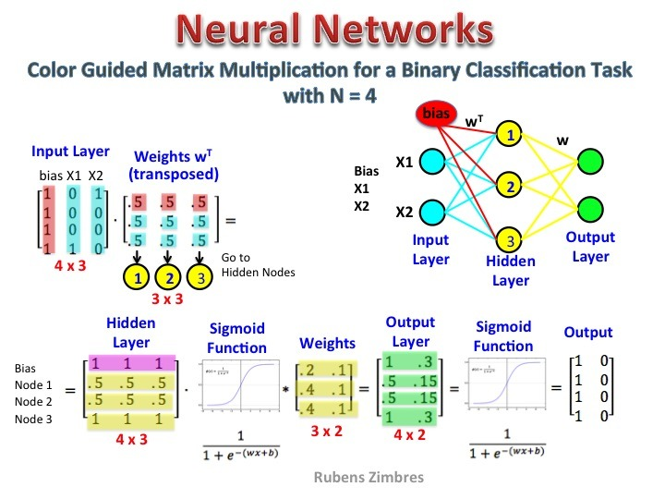
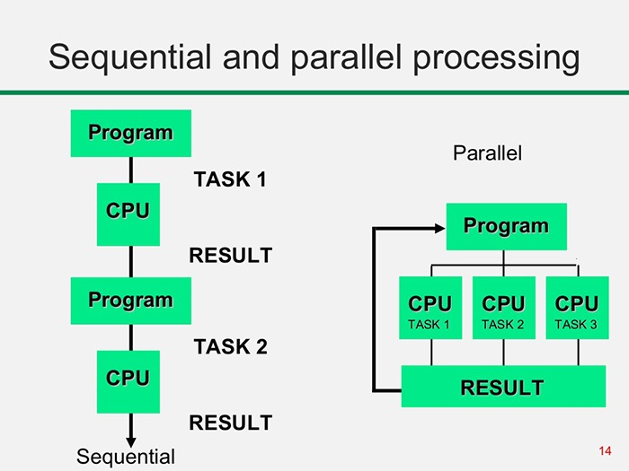
What is processor
A processor is an electronic circuit that executes instructions and performs calculations to run computer programs. It acts as the brain of a computer, handling tasks such as data processing, arithmetic operations, and decision-making. Processors can be classified into different types, including Central Processing Units (CPUs) for general computing, Graphics Processing Units (GPUs) for parallel processing and graphics rendering, Tensor Processing Units (TPUs) optimized for AI and machine learning, and Data Processing Units (DPUs) designed for high-speed networking, security, and cloud data management. Each type of processor is specialized to improve efficiency and performance in different computing environments.
1. Mathematical Operations in Neural Networks
2. Parallel Processing for Efficiency

Slide 4


What is processor
3. Real-Time Inference:
4. Scalability:
Real-time inference refers to the ability of neural networks to analyze and respond to data instantly. This is crucial for applications like voice assistants, self-driving cars, and facial recognition, where fast and accurate predictions are needed.
Scalability in neural networks means the ability to expand computing power by distributing workloads across multiple processors or cloud servers. This helps handle larger datasets, train bigger models, and improve performance without compromising speed.

Slide 5
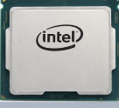
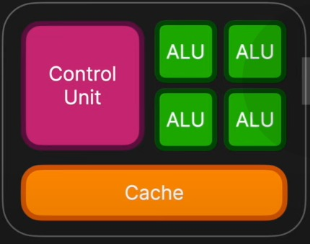
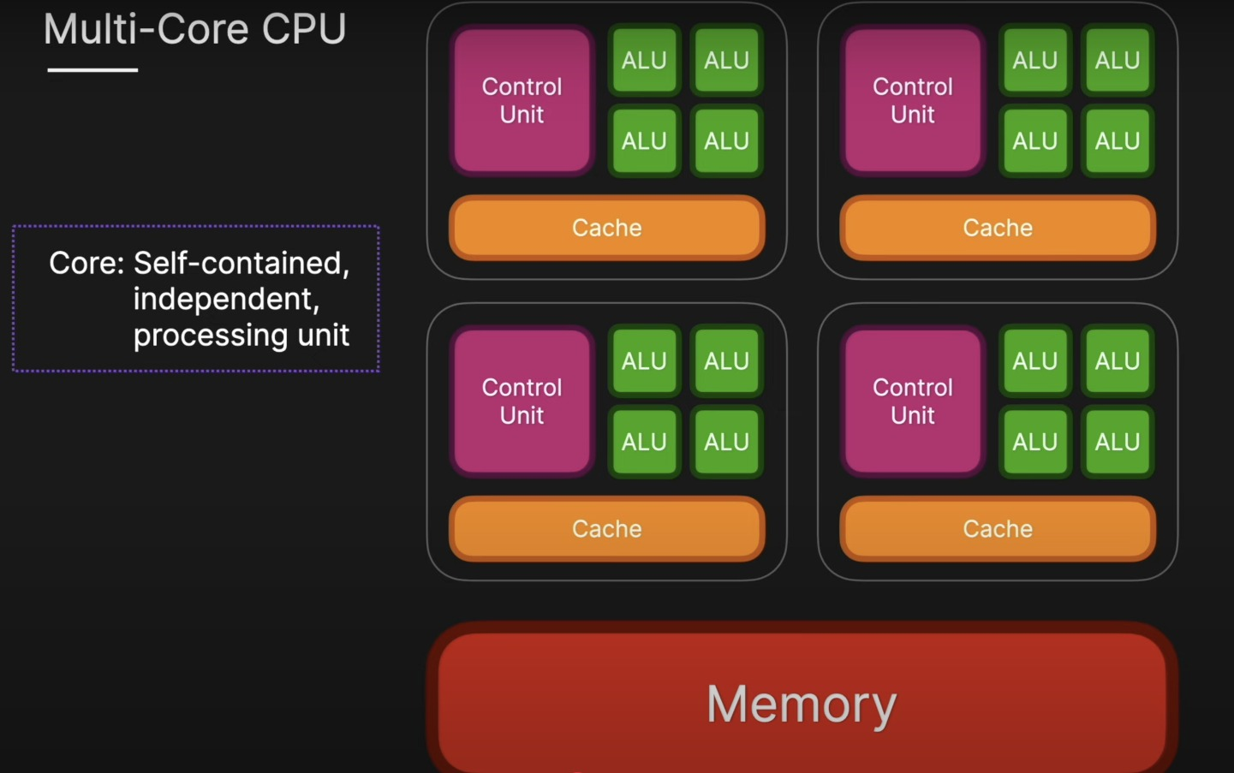
Type of processor
1. CPU (Central Processing Unit):
A CPU (Central Processing Unit) is the main processor of a computer that executes instructions and performs general-purpose tasks. It handles calculations, logic operations, and controls system processes. CPUs are optimized for sequential processing and are essential for running operating systems, applications, and general computing tasks.
Single-Core CPU:
Multi-Core CPU:
A single-core CPU has only one processing unit, meaning it can execute one task at a time. It processes instructions sequentially, which can slow down performance when handling multiple applications. Older computers and basic devices often use single-core processors.
A multi-core CPU has two or more processing units (cores) within a single chip. Each core can handle tasks independently or work together for better performance. This improves multitasking, speed, and efficiency, making multi-core CPUs ideal for gaming, video editing, and high-performance computing.

Slide 6
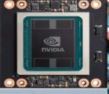
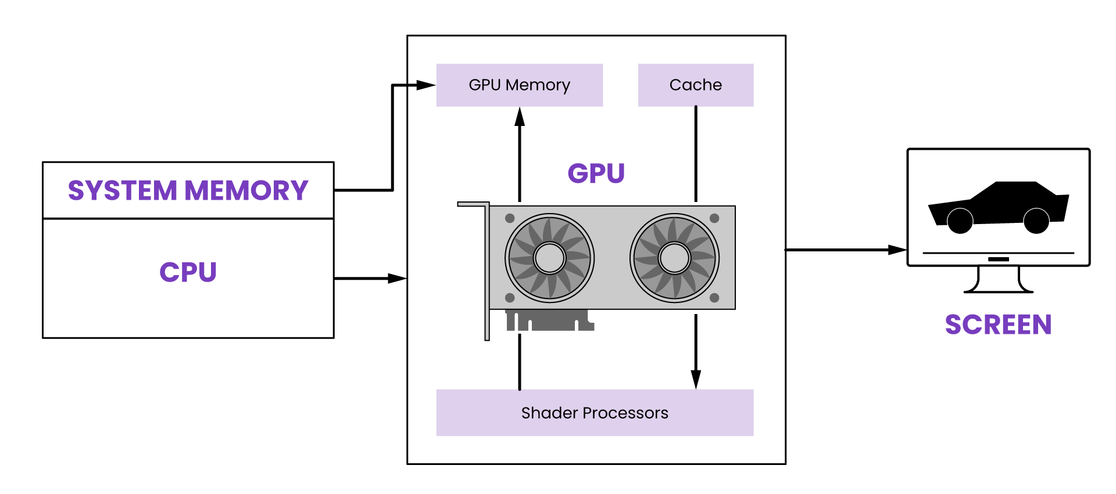
Type of processor
2. GPU (Graphics Processing Unit):
A GPU (Graphics Processing Unit) is a specialized processor designed for parallel computing, primarily used for rendering graphics and processing large amounts of data simultaneously. GPUs are highly efficient in handling tasks like deep learning, gaming, video editing, and scientific simulations due to their ability to perform multiple calculations at once.

Slide 7
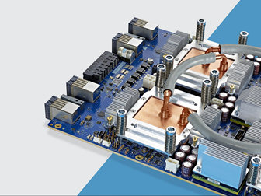
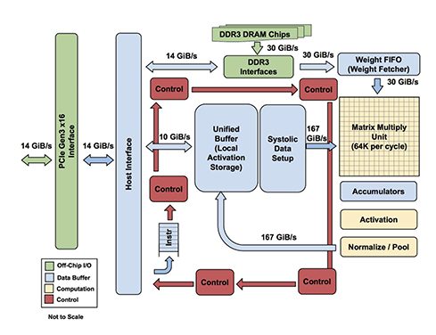
Type of processor
3. Tensor Processing Unit (TPU):
Role: TPUs are specialized processors designed to handle large-scale matrix operations, making them highly efficient for AI and machine learning tasks.
Example: Training a massive Hugging Face model on Google Cloud, where the TPU accelerates deep learning by recognizing patterns in text or images, significantly reducing training time compared to CPUs or GPUs.

Slide 8
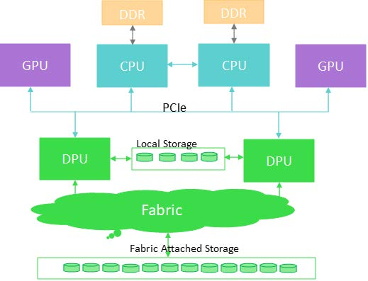
Type of processor
4. Data Processing Unit (DPU):
Role: DPUs are optimized for managing and accelerating data movement between different computing components, ensuring efficient networking, security, and cloud-based operations.
Example: Moving large datasets between GPUs in a distributed training environment without slowing down the process, ensuring that AI models can access and process data efficiently in cloud-based machine learning workloads.

Slide 9
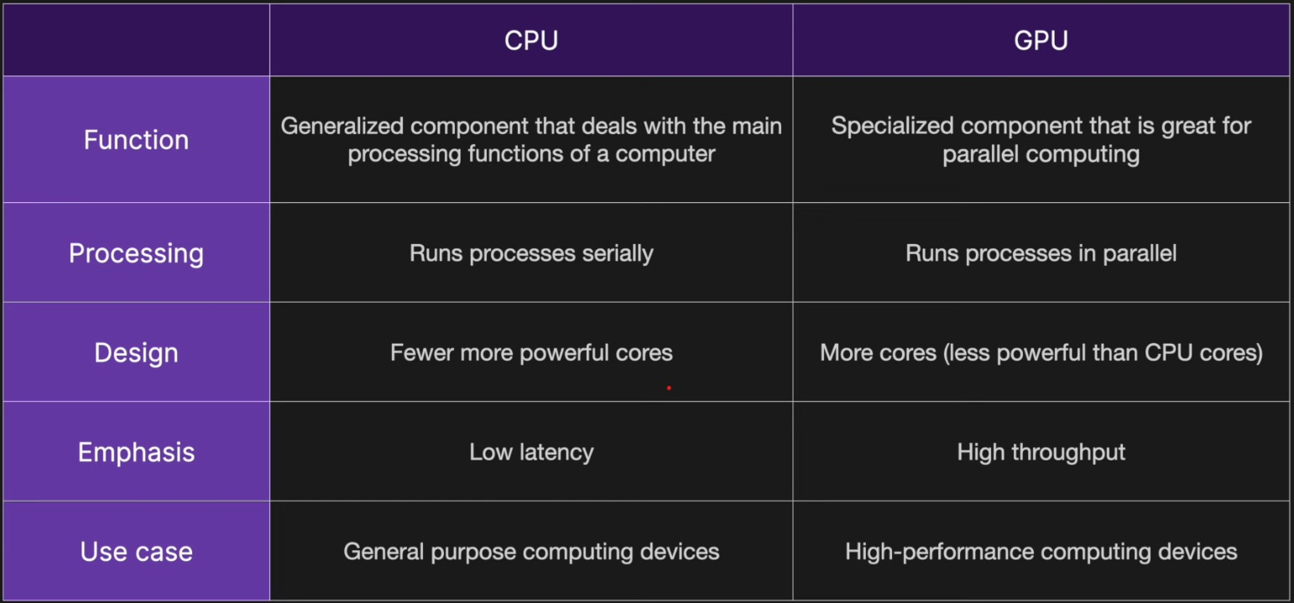
Core Differences

Slide 10
CPU and GPU company's
Feature | Intel (CPU) | AMD (CPU & GPU) | Nvidia (GPU) | Apple (CPU - ARM)
Market Leadership | Leader in CPU market for decades. | Strong competitor in CPUs and second in GPUs. | Dominates GPU market, especially in AI. | Gaining dominance in ARM-based computing with M1/M2 chips.
Product Types | CPUs for desktops, laptops, and servers. | CPUs, GPUs for gaming, and AI. | GPUs for gaming, AI, and data centers. | ARM-based CPUs for MacBooks, iPads, and custom hardware.
Popular Products | Intel Core i3/i5/i7/i9, Xeon. | Ryzen (CPU), Radeon RX (GPU). | GeForce RTX (gaming), Tesla/A100/H100 (AI). | M1, M2, M3 chips for Mac, iPad, and other Apple devices.
Performance | Best single-core performance. | Best multi-core performance (CPUs). Decent AI GPUs. | Best GPU performance for gaming, AI, and ML. | High efficiency, excellent performance per watt, optimized for Apple’s ecosystem.
AI & Machine Learning | Limited AI capability in CPUs. | Good, but not leading in GPUs for AI. | Best GPUs for AI training and inference. | Strong AI performance with Neural Engine, optimized for on-device machine learning.

Slide 11
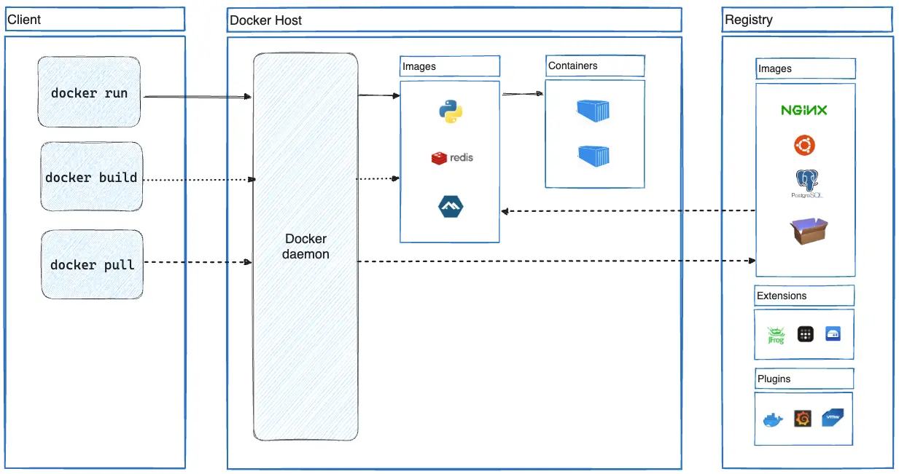

What is Docker
Docker is an open-source platform that allows developers to build, package, and run applications in isolated environments called containers. Containers ensure that an application runs consistently across different computing environments by bundling the code, dependencies, and system libraries together.
With Docker, developers can:
Simplify deployment by running the same application on any system without compatibility issues.
Improve scalability by quickly spinning up multiple containers as needed.
Enhance efficiency by using lightweight, fast-starting containers instead of traditional virtual machines.
Example: A developer can create a Docker container for a web application and run it on their laptop, a cloud server, or even Kubernetes without worrying about system differences.

Slide 12





